Slide 1
LIVE WEATHER FORECASTING
Using python

Slide 2
IMPORTANCE OF LIVE WEATHER FORECASTING
It not only shows about the Temperature, but also humidity, Maximum and Minumum Temperature, Sunrise and Sunset of desired city.
We can know temperature of any city along this globe

Slide 3
CODE:
import tkinter as tk
import requests
import time
def getWeather(canvas):
city = textField.get()
api = "https://api.openweathermap.org/data/2.5/weather?q="+city+"&appid=06c921750b9a82d8f5d1294e1586276f"
json_data = requests.get(api).json()
condition = json_data['weather'][0]['main’]
temp = int(json_data['main']['temp'] - 273.15)
min_temp = int(json_data['main']['temp_min'] - 273.15)
max_temp = int(json_data['main']['temp_max'] - 273.15)
pressure = json_data['main']['pressure’]
humidity = json_data['main']['humidity’]
wind = json_data['wind']['speed’]
sunrise = time.strftime('%I:%M:%S', time.gmtime(json_data['sys']['sunrise'] - 21600)) sunset = time.strftime('%I:%M:%S', time.gmtime(json_data['sys']['sunset'] - 21600)) final_info = condition + "\n" + str(temp) + "°C"
final_data = "\n"+ "Min Temp: " + str(min_temp) + "°C" + "\n" + "Max Temp: " + str(max_temp) + "°C" +"\n" + "Pressure: " + str(pressure) + "\n" +"Humidity: " + str(humidity) + "\n" +"Wind Speed: " + str(wind) + "\n" + "Sunrise: " + sunrise + "\n" + "Sunset: “+sunset

Slide 4
label1.config(text = final_info)
label2.config(text = final_data)
canvas = tk.Tk()
canvas.geometry("600x500")
canvas.title("Weather App")
f = ("poppins", 15, "bold")
t = ("poppins", 35, "bold")
textField = tk.Entry(canvas, justify='center', width = 20, font = t)
textField.pack(pady = 20)
textField.focus()
textField.bind('<Return>', getWeather)
label1 = tk.Label(canvas, font=t)
label1.pack()
label2 = tk.Label(canvas, font=f)
label2.pack()
canvas.mainloop()

Slide 5
Tkinter
IT COMES WITH ALL THE MODULE DEFINED IN TKINTER
.HOWEVER, TO SAVE THE MAJOR TYPING EFFORTS, WE IMPORT THE TKINTER LIBRARY WITH SOME ACRONYM FURTHER THAT CAN BE USEDTOCREATE A INSISTANCE OF WIDGETS
IT IS A GUI TOOLKIT

Slide 6
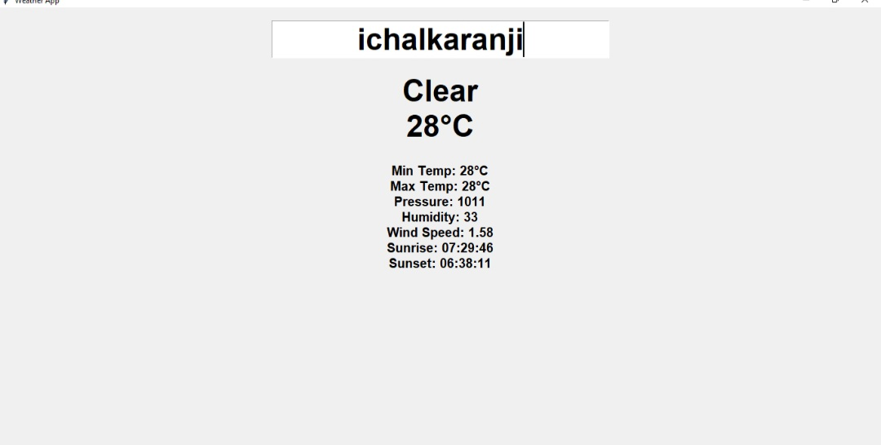
Example Output

Slide 7
IMPORT REQUESTS:
The Requests module allows you to send HTTP requests using python
The HTTP requests returns a response object with all the response data.

Slide 8
IMPORT TIME
This module is used to handle time related tasks

Slide 9
CANVAS WIDGET
It let us display various graphics on the application
It can be used to draw simple samples to complicated graphs

Slide 10
What Is API?
API Stands for Application Programming Interface
It describes everything an application programmer needs to know about piece of code to know how to use it

Slide 11
JsON DATA
JSON Stands for Java Script Object Notation
It is used to store and transfer data

Slide 12
By
PRAJWAL PRAMOD PATAKI (19UET028)
PRATHMESH RAJARAM PATIL (19UET029)
SURAJ SUNIL RAJMANE(19UET037)

Slide 13
THANK YOU……

